Slide 1


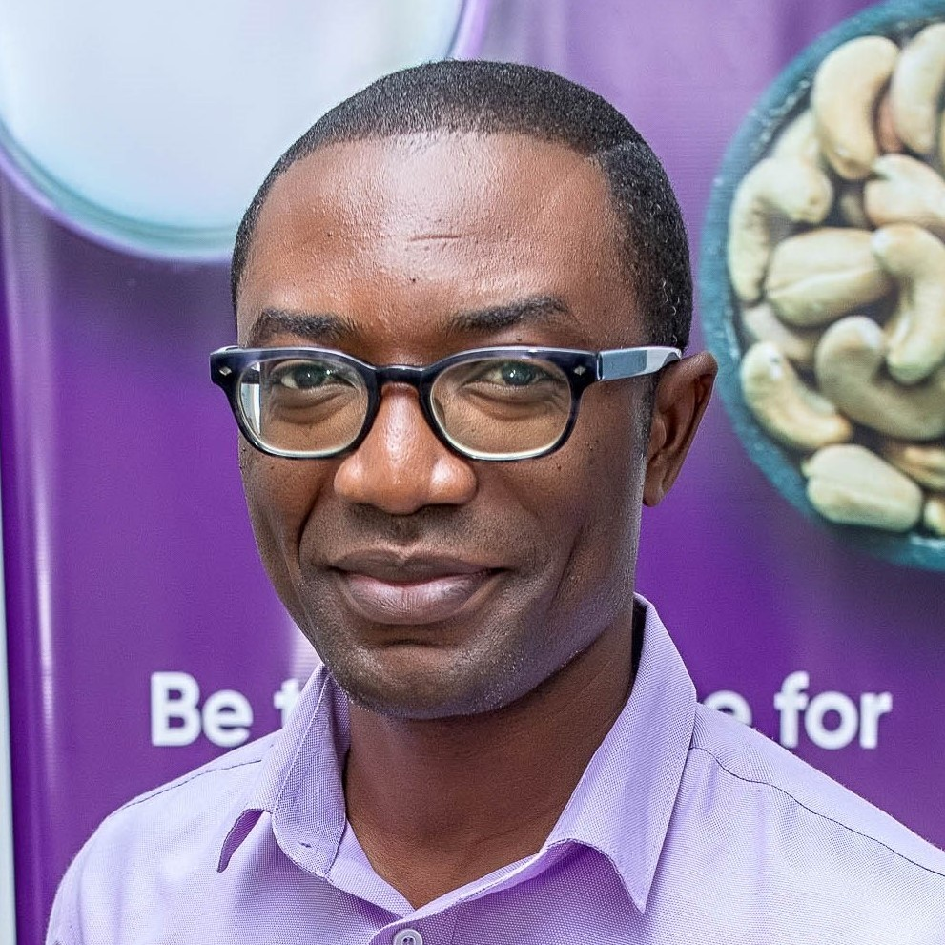
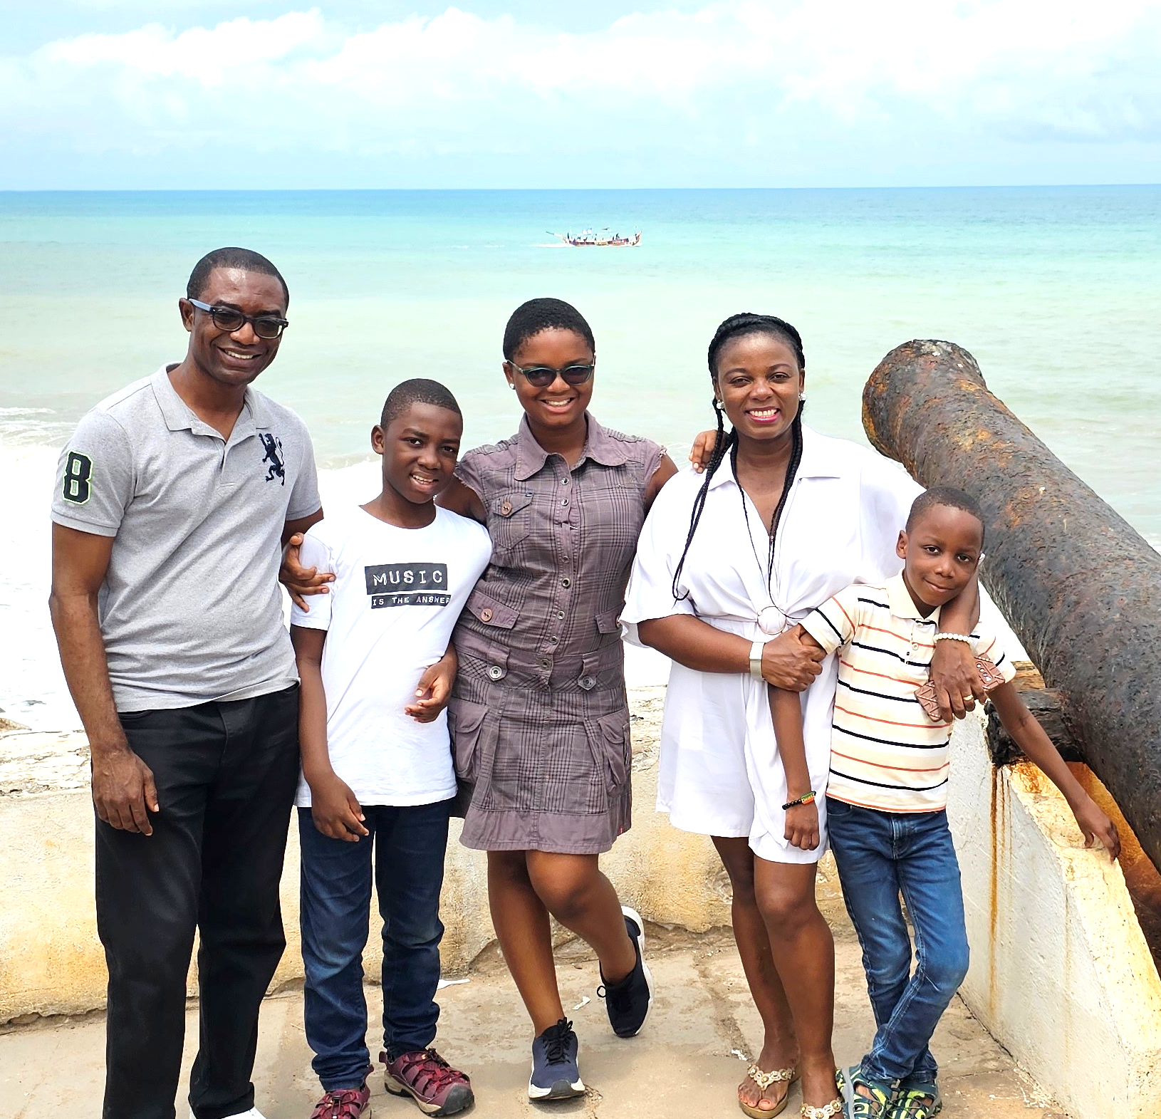
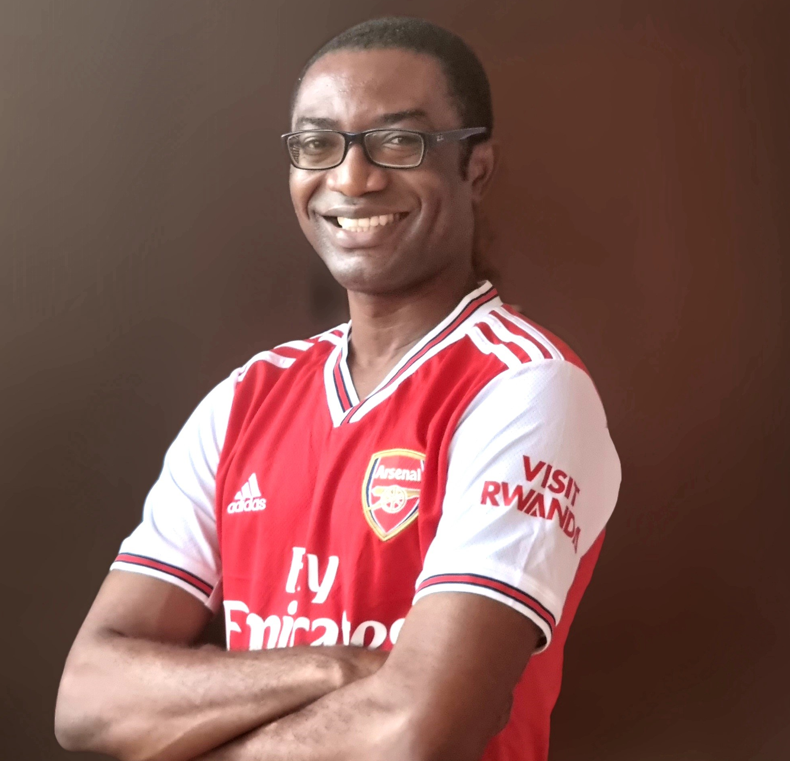
Getting to Know Me
Work
Personal
My role
Production Manager
Significant others / family members / furry friends in my life
Gloria, Cordelia, Brian Jnr., and Justin
Tenure in ofi/Olam
16 years
How I enjoy spending my free time
Playing video games with my kids
Previous companies I have worked at
Barry Callebaut Ghana
My favorite / comfort food
Rice balls with peanut soup
Why I joined ofi/Olam and what keeps me here?
For the opportunity of career growth and the great colleagues I work with.
My favorite song
Birds of a feather by Billie Eilish
Brian Owusu-Bempah
‘Brian’
A few fun facts about me
Growing up, I thought I would be a DJ. I tried my hands on PCDJ and BPM studio.
I won a dancing competition as a kid but now, I can’t dance to save myself.
This is me outside work, doing stuff I enjoy in my life …

